Slide 1

UNIT 2
Object – Oriented Programming (Java)
Dr Debabrata Swain
Department of Computer Science & Engineering
PDEU, Gandhinagar.

Slide 2

What is Object?
Any thing that has following two characteristics is termed as an object:
State
Behavior

Slide 3

Object : CAR
State Speed Gear
No: of passengers No: of seats
Color
Max: Speed
Behavior
Change gear
Apply brakes Accelerate Turn (Right and Left)

Slide 4

Object : TV
State ON OFF
Current Volume Current Channel
Behavior
Turn ON Turn OFF Increase Volume Decrease Volume Change Channel

Slide 5
Three OOP Features
Encapsulation
Inheritance
Polymorphism

Slide 6
Encapsulation
Encapsulation is the mechanism that binds together code and the data it manipulate.
In Java the basis of encapsulation is the class.
A class defines the structure and behavior (data and code) that will be shared by a set of objects.
The data defined by the class are referred to as
member variables or instance variables.
The code that operates on that data is referred to as member methods or just methods.

Slide 7
Inheritance
Inheritance is the process by which one object
acquires the properties of another object.
This is important because it supports the concept of hierarchical classification.

Slide 8
Polymorphism
Polymorphism (from the Greek, meaning “many forms”) is a feature that allows one interface to be used for a general class of actions.
The specific action is determined by the exact nature of the situation.

Slide 9
Classes and Objects in JAVA
class Class_Name //class keyword followed by name
{
//opening curly bracket of class
//declaring instance members/ variables in class access_specifier datatype member_name1; access_specifier datatype member_name2;
//declaring instance member functions/methods access_specifier return_type nameOfFunction1() {
//body of function1
}
access_specifier return_type nameOfFunction2() {
//body of function2
}
} //closing curly bracket of class

Slide 10
Example
class Student
{
//declaration of members / variables private int rollNo;
private String name;
//declaration of member functions/ method public void setData(int roll, String n) {
rollNo = roll ; name = n;
}
public void displayData() { System.out.println(“Roll No = “+rollNo); System.out.println(“Name = “+name);
}
}

Slide 11
Creating objects
public class ObjectDemo
{
public static void main(String args[])
{
//declaration of object
Student s1;//no memory created at this point for s1 s1=new Student(); //memory location at this point s1.setData(10,”Prashant”);
s1.displayData();
Student s2=new Student(); s2.setData(20,”ABCD”);
s2.displayData();
}
}

Slide 12
Memory Allocation in JAVA
When a Java program started Java Virtual Machine gets some memory from Operating System.
Part of this memory is call java heap memory.
Another part of memory available to the JVM is stack.
Stack memory stores primitive types and the addresses of objects.
Whenever you create a new Object, they are always stored in the heap
References to these objects are stored on stack.

Slide 13
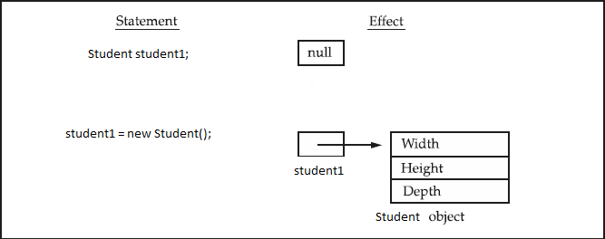

Slide 14
Memory Allocation in JAVA
As a Java programmer, you do not have to directly address memory allocation and recovery of memory space.
This is a common headache for C++ programmers.
When you need a new object, Java allocates the required memory.
When you are done with an object, the memory is reclaimed for you automatically via Java's garbage collection facility.

Slide 15
Constructors
Constructor is a special function in class which has
Function name equal to class name
No return type
e.g :-
class Emp
{
int empID;
public Emp() { //default constructor empID = 0;
}
public Emp(int id) {
empID = id;
}
//parameterized constructor
//we have overloaded constructors here i.e same function name with different number of parameters
}

Slide 16
Access Specifies in JAVA
Four access specifiers
public
private
protected
default(no specifier)

Slide 17
public specifier
Public Specifiers achieves the highest level of accessibility.
Classes, methods, and fields declared as public can be accessed from any class in the Java program, whether these classes are in the same package or in another package.
Example :
public class Demo { // public class
public int x, y, size; // public instance variables
}

Slide 18
private specifiers
Private Specifiers achieves the lowest level of accessibility.
private methods and fields can only be accessed within the same class to which the methods and fields belong.
private methods and fields are not visible within subclasses and are not inherited by subclasses.
Using Private Specifier we can hide data from the outside world.
Example :
public class Demo { // public class
private double x, y;
// private
//instance variables
}

Slide 19
protected specifiers
Methods and fields declared as protected can only be accessed by the subclasses in other package or any class within the package.
Example
public class Demo{
protected int x,y;
//protected instance
//variable
}

Slide 20
default(no specifier)
When you don't set access specifier for the element, it will follow the default accessibility level.
There is no default specifier keyword. Classes, variables, and methods can be default accessed.
Using default specifier we can access class, method, or field which belongs to same package, but not from outside this package.
Example :
class Demo {
int i; // default instance variable
}

Slide 21
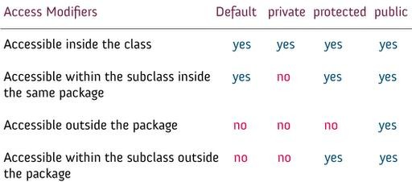
Access specifires summarized

Slide 22
this keyword
class Emp
{
int empID;
//Use this to resolve name-space collisions public Emp( int empID) {
this.empID = empID;
}
public void display(int empID)
{
S.o.p(empID);
S.o.p(this.empID);
// parameter empID
// class variable empID
}
}

Slide 23
Static keyword
class Car
{
int modelNo;
//instance variable
static int carsCreated = 0; car(int modelNo)
{
carCreated ++;
//class variable
this.modelNo = modelNo;
}
}

Slide 24
Static Variables and Methods
Belongs to the class and not to
object(instance)
Static variables are initialized only once , at the start of the execution.
Single copy
A static variable can be accessed directly by the
class name and doesn’t need any object
Syntax : <class-name>.<variable-name>
E.g Car.carsCreated;

Slide 25
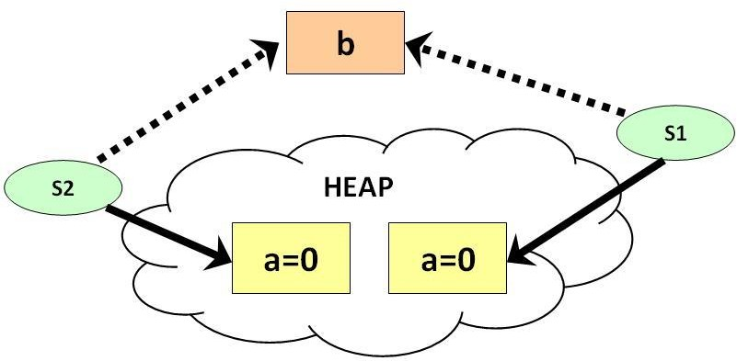
Static Members Shared

Slide 26
Programming Exercise
Create a class Hotel.
Include members :
Room_no
Register_ID
Total_no_of rooms.
Write method to register guest and allocated them a room no.. Keep decreasing the no. of rooms after each registration.

Slide 27
Inheritance
Inheritance is the process by which one object
acquires the properties of another object.
This is important because it supports the concept of hierarchical classification.

Slide 28
Types of Inheritance in JAVA
Simple
Multi-Level
Hierarchical
(*Note:- JAVA does not allow multiple inheritance.
Recall Diamond Ring Problem.)

Slide 29
Simple Inheritance
class Base
{
Base
……//members and member functions
}
Derived
class Derived extends Base
{
……//Derived class members and member
//function
}

Slide 30
Points to Remember
JAVA used extends keyword for implementing Inheritance.
General syntax for inheritance is
class subclass-name extends superclass-name{
}
You can only specify one superclass for any subclass
that you create.

Slide 31
super Keyword
super keyword is used to call base class
constructor or base class version of a methods.
To call a base class constructor syntax is
super(parameter-list-for-base-class-constructor)
To call a base class version of a method syntax is
super.name-of-function();

Slide 32
class A
{
int varA;
public A(int v1){
var1 = v1;
}
}
class B extends A
{
int varB;
public B(int v1,int v2) {
super(v1); varB = v2;
}
}
(*Note: call to super must be first statement inside constructor.)

Slide 33
class A {
int i;
void show(){
System.out.println(“I in A = ”+i);
}
}
class B extends A {
int i; // this i hides the i in A B(int a, int b) {
super.i = a; // i in A i = b; // i in B
}
void disp() {
System.out.println("i in superclass: " +super.show());
System.out.println("i in subclass: " + i);
}
}

Slide 34
Method Overriding
class A{
void show(){
System.out.println(“show method in A”);
}
}
class B extends A{
void show(){
System.out.println(“show method in B”);
}
public static void main(String args[]) { B o1 = new B();
Output:
o1.show();
}
}
show method in B

Slide 35
Dynamic Method Dispatch
Dynamic method dispatch is the mechanism by which a call to an overridden method is resolved at run time, rather than compile time.
Dynamic method dispatch is important because this is how Java implements run-time polymorphism.
A superclass reference variable can refer to a subclass object.
When an overridden method is called through a superclass reference, Java determines which version of that method to execute based upon the type of the object being referred to at the time the call occurs.

Slide 36
class A {
class Dispatch {
public static void main(String args[]) { A a = new A(); // object of type A
B b = new B(); // object of type B C c = new C(); // object of type C A r; // obtain a reference of type A r = a; // r refers to an A object
r.callme(); // calls A's version of callme r = b; // r refers to a B object r.callme(); // calls B's version of callme r = c; // r refers to a C object r.callme(); // calls C's version of callme
}
}
OUTPUT:
Inside A’s callme method. Inside B’s callme method. Inside C’s callme method.
void callme() {
S.o.p("Inside A's callme method");
}
}
class B extends A { void callme() {
S.o.p("Inside B's callme method");
}
}
class C extends A { void callme() {
S.o.p("Inside C's callme method");
}
}

Slide 37
final Keyword
final keyword can be used with variable, method or class.
1) final int var1 = 10;
//declares constant, must
//be initialised.
final void show(){
…..
}
Final method can not be overridden in derived class
final class A{
…..
}
Final class can not be inherited by other classes.

Slide 38
Abstract Classes
An abstract class is a class that is declared abstract—it may or may not include abstract methods.
Abstract class can not be instantiated.
It needs to be extended by another class and its method must be implemented.
A method that is declared as abstract and does not have implementation is known as abstract method.
Abstract class can have constructors , member variables and normal methods.

Slide 39

An Abstract Class Example
abstract class GraphicObject {
int x, y;
...
void moveTo(int newX, int newY) {
...
}
abstract void draw();
abstract void resize();
//non abstract method
//abstract method
//abstract method
}

Slide 40
class Circle extends GraphicObject {
void draw() {
...
}
void resize() {
...
}
//implementation of abstract method
//implementation of abstract method
}
class Rectangle extends GraphicObject {
void draw() {
...
}
void resize() {
...
}
//implementation of abstract method
//implementation of abstract method
}

Slide 41
When to use abstract methods and abstract class
Abstract methods are usually declared where two or more subclasses are expected to do a similar thing in different ways through different implementation.

Slide 42
Interfaces
An interface is a collection of abstract methods.
A class implements an interface, thereby inheriting the abstract methods of the interface.
You cannot instantiate an interface.
All of the methods in an interface are abstract.
An interface cannot contain instance fields. The only fields that can appear in an interface must be declared both static and final.
An interface is not extended by a class; it is
implemented by a class.
An interface can extend multiple interfaces.

Slide 43
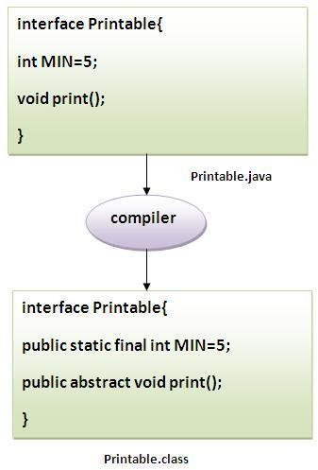

Slide 44
interface printable{
void print();
}
class A implements printable{ public void print(){
System.out.println("Hello");
}
public static void main(String args[] ){ A obj = new A();
obj.print();
}
}

Slide 45
Multiple inheritance in Java by interface
interface Printable{ void print();
}
interface Showable{ void show();
}
class A implements Printable, Showable {
public void print() {
System.out.println("Hello");
}
public void show() {
System.out.println("Welcome");
}
}

Slide 46
Interface
Abstract Class
Abstract class can extend only one class or one abstract class at a time.
Abstract class can extend from a class or from an abstract class
Abstract class can have both abstract and concrete methods.
A class can extend only one abstract class
Abstract class can have protected
, public and public abstract
methods
Abstract class can have static, final or static final variable with any access specifiers.
Interface can extend any number of interfaces at a time.
Interface can extend only from an interface
Interface can have only abstract methods
A class can implement any
number of interfaces
Interface can have only public abstract methods
Interface can have only static final (constant) variable.

Slide 47
Package
A package is a namespace that organizes a set of related classes and interfaces.
A package allows a developer to group classes (and interfaces) together.
Conceptually you can think of packages as being similar to different folders on your computer.
E.g. HTML file in one folder, Audio files in other, images in other folder and so on.

Slide 48
Java Package
A java package is a group of similar types of classes, interfaces and sub-packages.
Java package is used to categorize the classes and interfaces so that they can be easily maintained.
Provides extra Access control mechanism i.e
default access.

Slide 49
Why should we bundle classes or interfaces together?
You and other programmers can easily determine that these types are related.
You and other programmers know where to find types that can provide related functions.
The names of your types won't conflict with the type names in other packages because the package creates a new namespace.
You can allow types within the package to have unrestricted access to one another yet still restrict access for types outside the package.

Slide 50
Advantages of Packages
Java package is used to categorize the classes and interfaces so that they can be easily maintained.
Java package provides access protection.
Java package removes naming collision.
This is the general form of the package statement: package pkgname;
e.g. package mypackage;
We can also create subpackages package pkg1[.pkg2[.pkg3]];

Slide 51
package mypack;
public class employee
{
...statement;
}
You can create a hierarchy of packages. To do so, simply separate each package name from the one above it by use of a period. The general form of a multileveled package statement is shown here:
e.g. package pkg1[.pkg2[.pkg3]];

Slide 52
Finding Packages and CLASSPATH
packages are mirrored by directories.
How does the Java run-time system know where to look for packages that you create?
Current working directory as its starting point.
Specify a directory path or paths by setting the
CLASSPATH environmental variable.

Slide 53
Exception Handling
An exception is an abnormal
condition that occurs at run time.
Exceptions needs to be handled so that appropriate actions can be taken.

Slide 54
Whenever error occurs in Java Runtime system it will create
The object, called an exception object.
Exception Object contains information about the error, including its type and
the state of the program when the error occurred.
Creating an exception object and handing it to the runtime system is called throwing an exception.

Slide 55
What will happen with following code?
package trial;
public class Trial2 {
public static void main( String args[] )
{
int i =0; int y=10/i;
}
}
Output:
Exception in thread "main" java.lang.ArithmeticException: / by zero at trial.Trial2.main(Trial2.java:17)

Slide 56
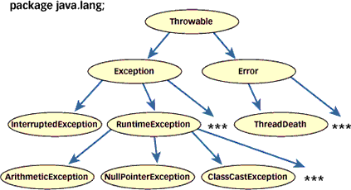
Exception class Hierarchy
Every Exception type is basically an object belonging to class Exception
Throwable class is the root class of Exceptions.
Throwable class has two direct subclasses named Exception, Error

Slide 57
Types of Exceptions
A. Unchecked Exceptions
All Exceptions that extend the RuntimeException or any
one of its subclass are unchecked exceptions
Unchecked Exceptions are unchecked by compiler.
Whether you catch the exception or not compiler will pass
the compilation process.
If Unchecked exception is caught then exception handling code will be executed and program’s execution continues.
If Unchecked exception is not caught then java interpreter
will provide the default handler. But in this case execution
of the program will be stopped by displaying the name of the exceptions object.

Slide 58
Unchecked Exceptions
Some Common Unchecked Exceptions
ArithmaticException (Divide By 0)
ArrayIndexOutOfBoundsException
FileNotFoundException
NullPointerException
Throwable
NumberFormatException
IllegalArumentsException
Exception
Error
RunTimeException
All Unchecked Exceptions directly or indirectly are sub classes of RunTimeException
Any Class belonging to RunTimeException

Slide 59
UncheckedExceptions Example
class Exceptiondemo1 { public static void main(String arhs[]) { int a=10; int b= 5; int c =5;
int x = a/(b-c); // Dynamic Initilization
System.out.println("c="+c); int y = a/(b+c); System.out.println("y="+y); } } D:\java\bin>javac Exceptiondemo1.jav
throws ArithmeticException
No Need to mention for
Unchecked Exceptions
Can Throw an Exception
a << Compilation Step Pass>>
D:\java\bin>java Exceptiondemo1
Exception in thread "main"
java.lang.ArithmeticException: / by zero
at Exceptiondemo1.main(Exceptiondemo1.java:8)

Slide 60
Example 2 (Unchecked Exceptions)
class Exceptiondemo2
Can throw either ArrayIndexOutOfBoundsException
OR
NumberFormatException
{
public static void main(String args[])
{
double a= Double.parseDouble(args[0]);
}
}
D:\java\bin>javac Exceptiondemo2.java
D:\java\bin>java Exceptiondemo2
Exception in thread "main" java.lang.ArrayIndexOutOfBoundsException: 0 at Exceptiondemo2.main(Exceptiondemo2.java:5)

Slide 61
Types of Exceptions
B Checked Exceptions
All Exceptions that extends the Exception or any one its subclass except RunTimeException class are checked exceptions
Checked Exceptions are checked by the Java compiler.
There are two approaches that a user can follow to deal with checked exceptions

Slide 62
Handling Checked Exceptions
Inform the compiler that a method can throw an Exception.
Catch the checked exception in try catch block
If Checked exception is caught then exception handling code will be executed and program’s execution continues.
If Checked exception is not caught then java interpreter will provide the default handler. But in this case execution of the program will be stopped by displaying the name of the exceptions object.

Slide 63
Checked Exceptions Examples
Some Common Checked Exceptions
IOException
ClassNotFoundExceptions
InterruptedException
NoSuchMethodException
Throwable
Exception |  |  | Error
Any Sub Class belonging to Exception
EXCEPT
RuntimeException

Slide 64
Checked Exceptions
/* Program to read two integers Display their sum */
import java.io.*;
class Exceptiondemo3
{
public static void main(String args[])
{
WILL THIS CODE COMPILE SUCCESSFULLY
BufferedReader br = new BufferedReader(new InputStreamReader(System.in));
int a = Integer.parseInt(br.readLine());
int b = Integer.parseInt(br.readLine());
System.out.println("Sum is :"+(a+b));
}
}
Exceptiondemo3.java:9: unreported exception java.io.IOException; must be caught or declared to be thrown
int a = Integer.parseInt(br.readLine()); ^ Exceptiondemo3.java:10: unreported exception java.io.IOException; must be caugh or declared to be thrown
int b = Integer.parseInt(br.readLine()); ^

Slide 65
Ways To Handle Checked Exceptions
Method 1: << Mention thru throws clause>> import java.io.*;
class Exceptiondemo3
{
public static void main(String args[]) throws IOException
{
BufferedReader br = new BufferedReader(new inputStreamReader(System.in));
int a = Integer.parseInt(br.readLine()); int b = Integer.parseInt(br.readLine()); System.out.println("Sum is :"+(a+b));
}
}
throws clause is used with methods to indicate type of Exception a method can throw
Specifically required for Checked Exceptions [ To Pass Compilation process]. It can/may be used for unchecked exceptions also.
A method can throw as many exceptions.

Slide 66
Ways To Handle Checked Exceptions
cont….
Method 2 << Put the statements in try catch block and catch >> import java.io.*;
class Exceptiondemo3
{
public static void main(String args[])
{
BufferedReader br = new BufferedReader(new inputStreamReader(System.in));
try {
int a = Integer.parseInt(br.readLine()); int b = Integer.parseInt(br.readLine()); System.out.println("Sum is :"+(a+b));
}
catch(IOException e) { }
}
}

Slide 67
Exception Handling
Exception Handling Requires the Following four steps
Finding the problem (Identify the statements whose execution may result in Exception. Put all those statements in a try{..} block)
Inform that an exception is thrown (Throw the Exception) << Note Down throw vs throws>>
Receive the exception ( Catch the exception using
catch{..} block)
Provide exception handling code in catch block.

Slide 68
Exception Hadling Syntax
try
{
<statements that can throw exceptions>
}
catch(ExceptionType<1> e1) {….} catch(ExceptionType<2> e2) {….} catch(ExceptionType<3> e3) {….}
……………………………….. catch(ExceptionType<N> e4) {….}
Important Points :
1. try {} block may have one or
multiple statements.
try{} block may throw a single type of Exception or multiple exceptions. But at a time it can generate only single type of exception.
There can be multiple catch() {
.. } blocks associated with single try{} block.
If try{} block can throw multiple exceptions then user should catch all exceptions. (one catch block for each type of exception)

Slide 69
Catching an Exception
class Exceptiondemo1
{
public static void main(String arhs[])
{
int a=10; int b= 5;
int c =5; try
{
int x = a/(b-c);
System.out.println("c="+c);
}
catch(ArithmeticException e)
{
D:\java\bin>java Exceptiondemo1 java.lang.ArithmeticException: / by zero y=1
System.out.println(e.toString());
}
int y = a/(b+c);
System.out.println("y="+y);
}
}

Slide 70
Catching Multiple Exceptions
class Exceptiondemo4
{
public static void main(String args[])
{
int a[]= {5,10};
try
{
int b= Integer.parseInt(args[0]);
int x = a[b]/(b-a[1]); System.out.println("x="+x);
}
catch(ArithmeticException e)
{
System.out.println(e.toString());
}
catch(NumberFormatException e)
{
System.out.println(e.toString());
}
catch(ArrayIndexOutOfBoundsException e)
{
System.out.println(e.toString());
}
This Statement is outside catch block and will be executed in any case
System.out.println("Hello This is Exception Test");
} // End of main() method
}// End of class Exceptiondemo4

Slide 71
OUTPUT
What will be o/p if you execute it like
java Exceptiondemo4
java Exceptiondemo4 1
java exceptiondemo4 oop
NO COMMAND LINE ARGUMENTS
COMMAND LINE ARGUMENTS PASSED AS 1
COMMAND LINE ARGUMENT
PASSED oop

Slide 72
Nested Try Statements
Try{ } statements can be nested. One try block may contain another try block
In case of nested try blocks, context of that exception is
pushed onto stack.
Inner try block may/or may not have catch statements associated with it.
If an exception is thrown from inner try block then first inner catch statements are matched (if present) . If no match is found then outer try block are matched. If there also no match found then default handler will be invoked.
However, if outer try block throws the exception then only outer
try blocks are matched.

Slide 73
Nested try blocks
A typical Syntax
try
{
Statement A; Statement B; try
{
Statement C; Statement D;
}
catch(CException e) { …. } catch(DException e) { …. }
}
catch(AException e) { …. } catch(BException e) { …. }

Slide 74
Use of finally Clause
finally statement can be used to handle an exception
that is not caught by previous statements.
finally block in general used to perform house keeping operations such as closing files or releasing system resources.
Finally block when present is guaranteed to execute regardless of whether an exception is thrown or not.
If you want then finally block can be used to handle any
exception generated within a try block.
finally block may be added immediately after try block or after the last catch block.

Slide 75
finally clause Syntax
try
{
…………………..
……………………..
…………………….
}
catch(……….)
{ ……………. }
catch(………..)
{ ……………. }
…..
….. finally
{
…………..
…………..
}
try
{
…………………..
……………………..
…………………….
}
finally
{
……………..
……………..
…………….
}

Slide 76
Example(finally clause)
class ex10
{
public static void main(String args[])
{
int a = 10; int b = 20; try
{
int y = b/(b-a); System.out.println(“ y = “+y);
}
finally
{
OUTPUT:
y=2
Finally block executed
System.out.println(“Finally block executed");
}
}

Slide 77
Example(finally clause)
class ex10
{
public static void main(String args[])
{
int a = 10; int b = 20; try
{
int y = b/(b-b); System.out.println(“ y = “+y);
}
finally
{
OUTPUT:
Finally block executed
System.out.println(“Finally block executed");
}
}

Slide 78
Example(finally clause)
class ex10
{
public static void main(String args[])
{
int a = 10; int b = 20; try
{
int y = b/(b-b); System.out.println(“ y = “+y);
}
catch(Exception e)
{
System.out.println(“Error in ur Code”);
}
finally
{
OUTPUT:
Error in ur Code Finally block executed
System.out.println(“Finally block executed");
}
}

Slide 79
Creating a User-Defined Exception
You can create your own Exception simply by Extending java Exception class.
You can override toString() method to display your customized message on catch.

Slide 80
class MyException extends Exception
{
public String toString()
{
return "Please enter a number > 5";
}
}
public class User_Exception {
public static void main(String args[])
{
try{
int i=4; if(i<5)
throw new MyException();
// I'm throwing user defined custom exception
above
}
catch(MyException exp){
System.out.println("Hi this is my catch
block") ;
System.out.println(exp) ;
}
}
Output:
Hi this is my catch block Please enter a number > 5
}

Slide 81
What is Automatic Garbage Collection?
Automatic garbage collection is the process of looking at heap memory, identifying which objects are in use and which are not, and deleting the unused objects.
In use object, or a referenced object :- some part of your program still maintains a pointer to that object.
Unused Object :- is no longer referenced by any part of your program

Slide 82
Garbage Collection…..
In a programming language like C, allocating and deallocating memory is a manual process.
In Java, process of deallocating memory is handled automatically by the garbage collector.
Mark-and-Sweep-Algorithm is used for this purpose.

Slide 83
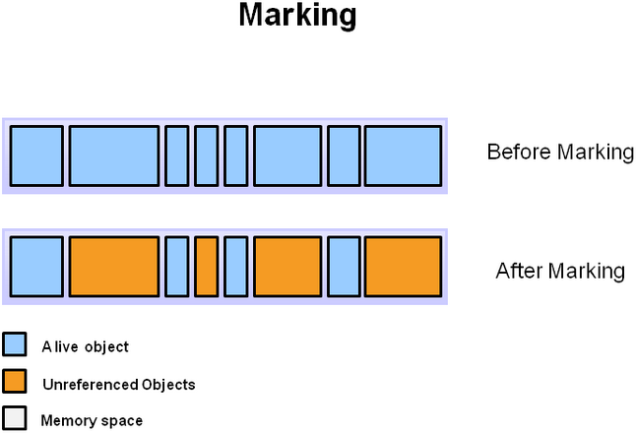

Slide 84
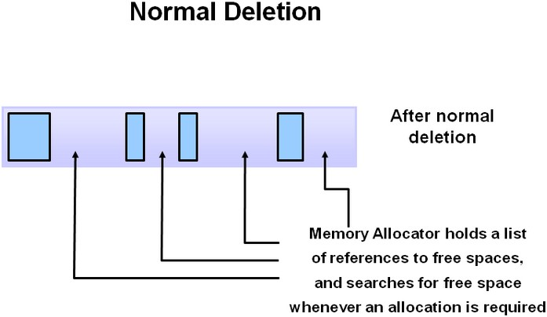

Slide 85
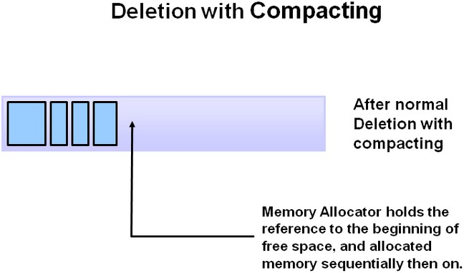

Slide 86
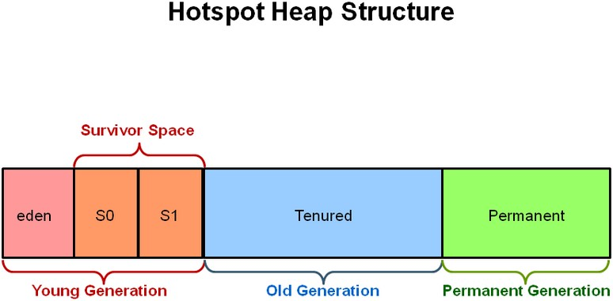
Generation Garbage Collection

Slide 87
C++ vs JAVA
 | C++ | JAVA
Platform | Platform Dependent | Platform Independent
Destructor | ~ClassName(){ } | finalize() { }
Access | Public | Public
Modifiers | Private | Private
 | Protected | Protected
 |  | Default
Inheritance | Simple | Simple
 | Multilevel | Multilevel
 | Multiple | Hierarchical
 | Hybrid
 | Hierarchical
C++

Slide 88
C++ vs JAVA
 | C++ | JAVA
Polymorphism 1)Static | Function overloading Operator overloading | Function Overloading
2)Dynamic | Function overriding Using virtual keyword (function) | Function Overriding No need of virtual keyword.
Garbage Collection | No automatic garbage collection. | Automatic garbage collection.

Slide 89
MCQs
What is the output of the following program? class MyClass
{
public static void main(String[] args)
{
int x; x=test();
System.out.println("x="+x);
}
static int test()
{
System.out.println("Inside Test()");
}
}
Inside Test() x=0
Compilation Error
None of the Above
OUTPUT:
B. Compilation error

Slide 90
Which three are legal array declarations?
int [] myScores [];
char [] myChars; int [6] myScores; Dog myDogs []; Dog myDogs [7];
Correct Option:- A
A. 1, 2, 4
C. 2, 3, 4
B. 2, 4, 5
D. All are correct.

Slide 91
Which is the valid declarations within an interface definition?
public double methodA();
public final double methodA();
static void methodA(double d1);
protected void methodA(double d1);
Correct Option:- A

Slide 92
What is process of defining two or more methods within same class that have same name but different parameters declaration?
method overriding
method overloading
method hiding
None of the mentioned
Correct Option:-B

Slide 93
Which of the following statements are incorrect?
Default constructor is called at the time of creation of the object if a constructor has not been defined.
Constructor can be parameterized.
finalize() method is called when a object goes out of scope and is no longer needed.
finalize() method must be declared protected.
Correct Option:- C

Slide 94
int z,x=5,y=-10,b=2; z=x++ - - - y/b;
What will be the value of z?
20
10
11
5
Correct Answer : b

Slide 95
class overload {
int x;
int y;
void add(int a) { x = a + 1;
}
void add(int a, int b){
x = a + 2;
}
}
class Overload_methods {
public static void main(String args[])
{
overload obj = new overload();
int a = 0;
obj.add(6);
System.out.println(obj.x);
}
}
What is the output of this program?
5
6
7
8
Correct Option:- C

Slide 96
class test {
int a;
int b;
test(int i, int j) { a = i;
b = j;
}
void meth(test o) {
*= 2;
/= 2;
}
class Output {
public static void main(String args[])
{
test b1 = new test(10, 20); test b2 = new test(10, 20); b1.math(b2);
System.out.println(b2.a+” ”+b2.b);
}
}
}
What is the output of this program? a) 10 20
b) 20 10
c) 20 40
d) 40 20
Correct Option:- b

Slide 97
public class Trial {
public static void main(String[] args)
{
hello();
}
void hello()
{
System.out.println(“Hello World");
}
Correct Answer : B
non-static method test() cannot be referenced from a static context
}
What will be the output of above program?
Hello World
Compilation Error
None of the Above

Slide 98
Thank you

